Slide 1

Write here

Slide 2
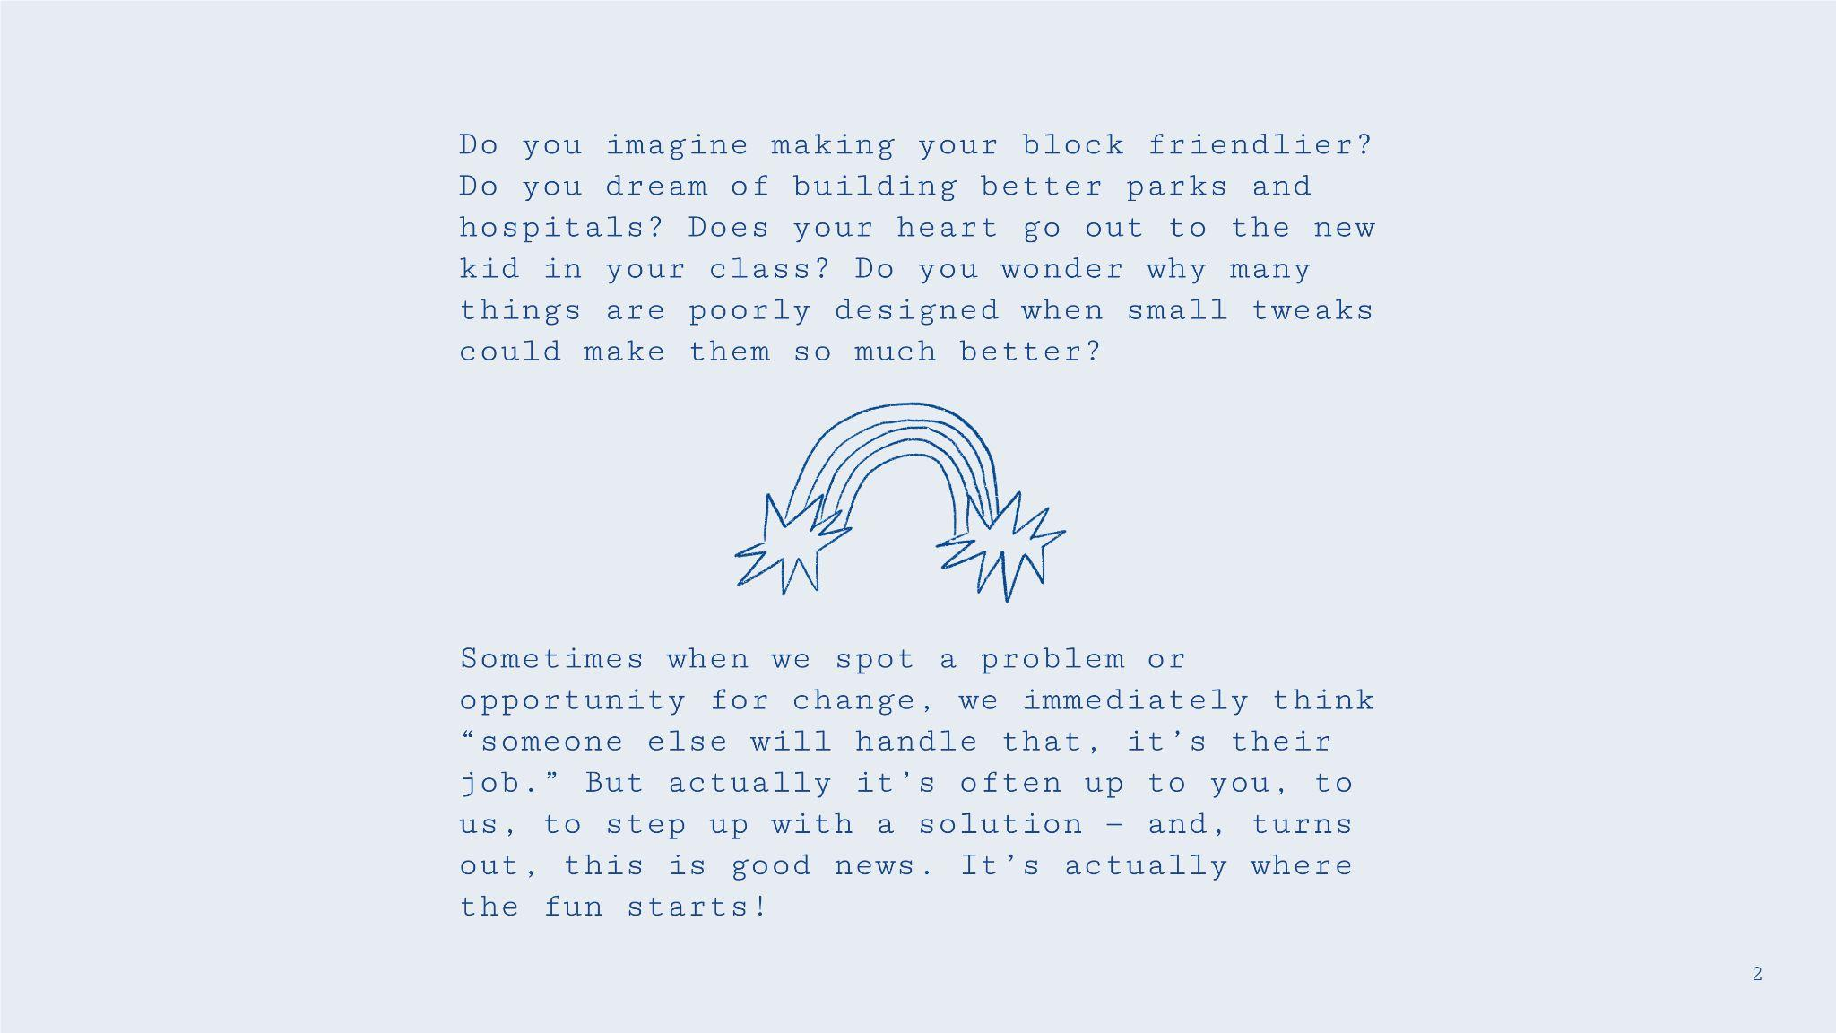

Slide 3
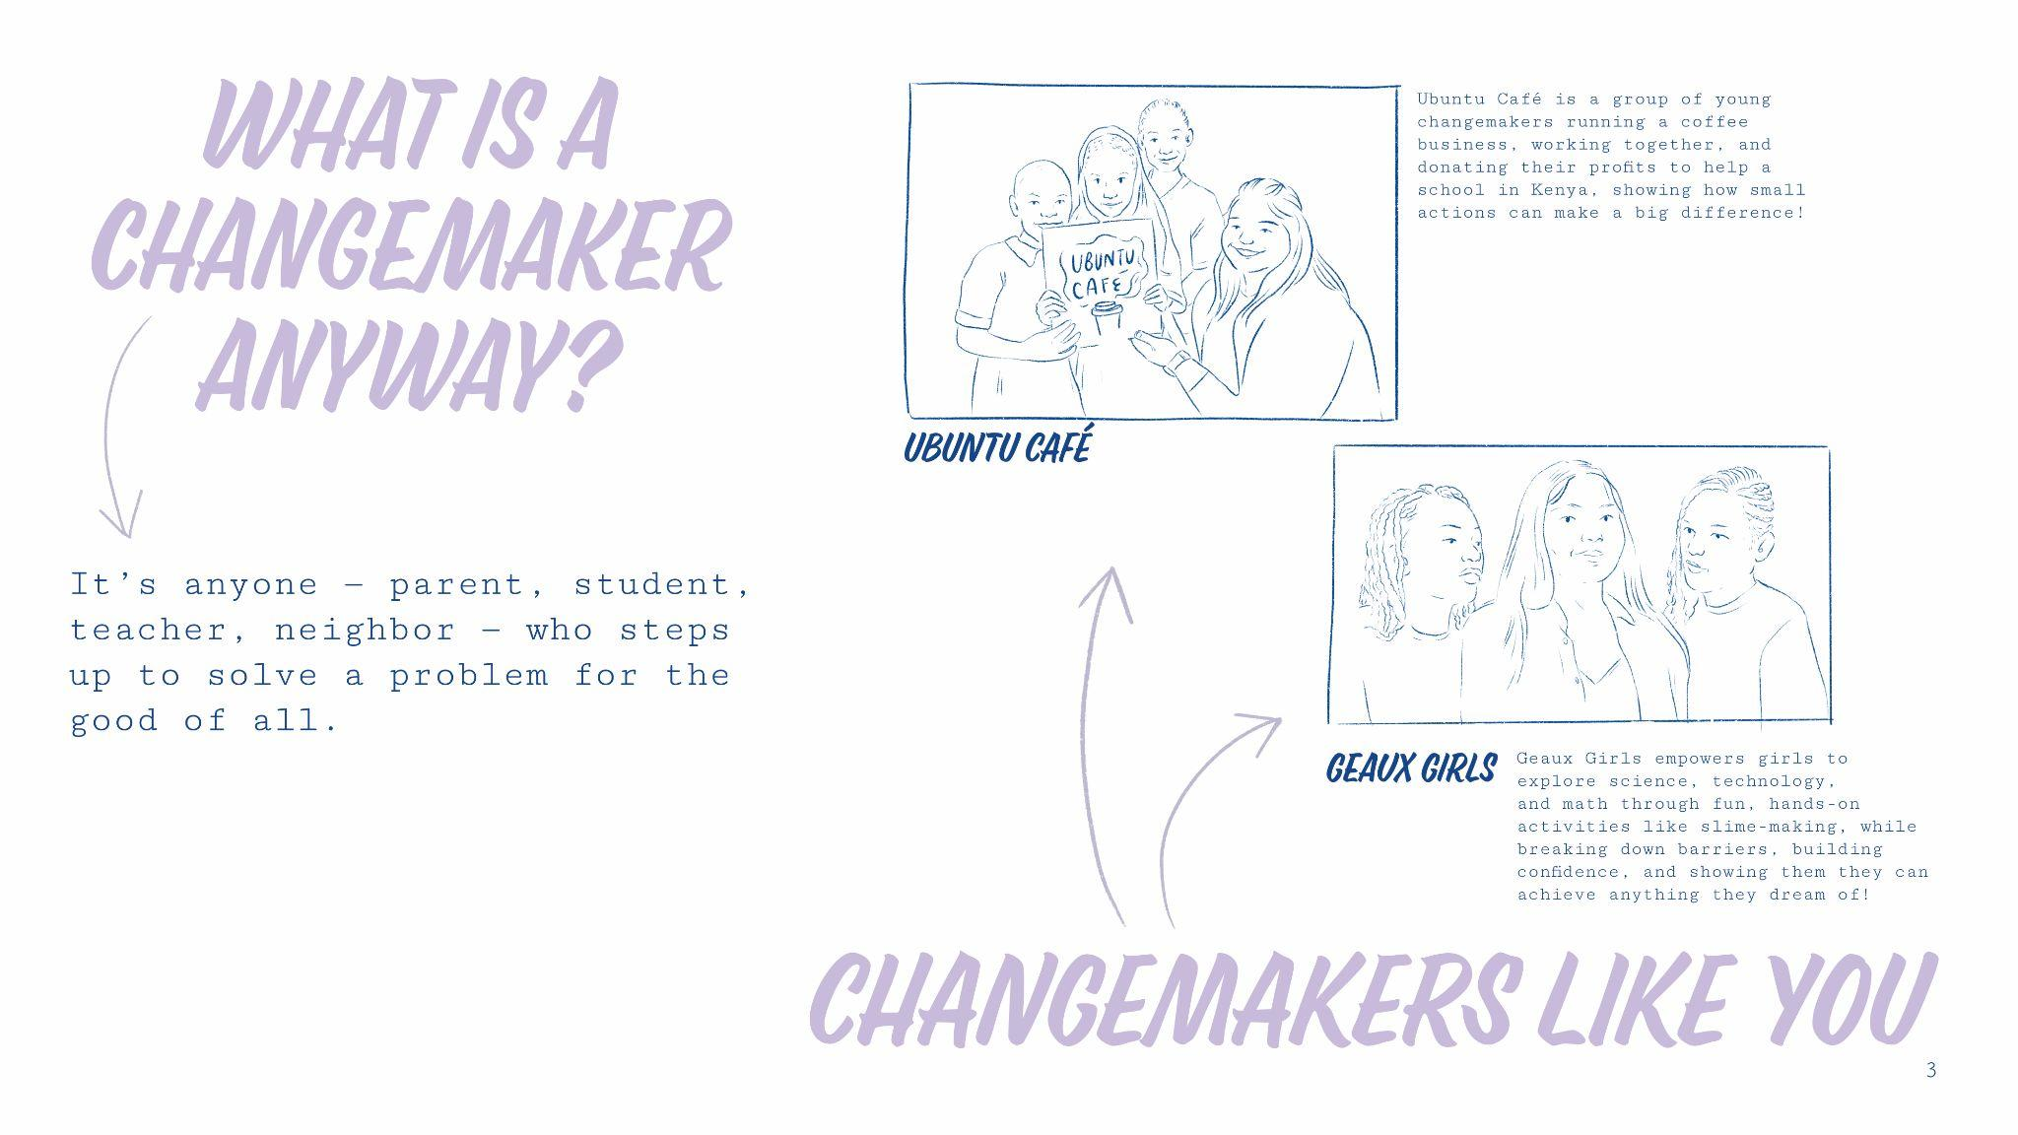

Slide 4
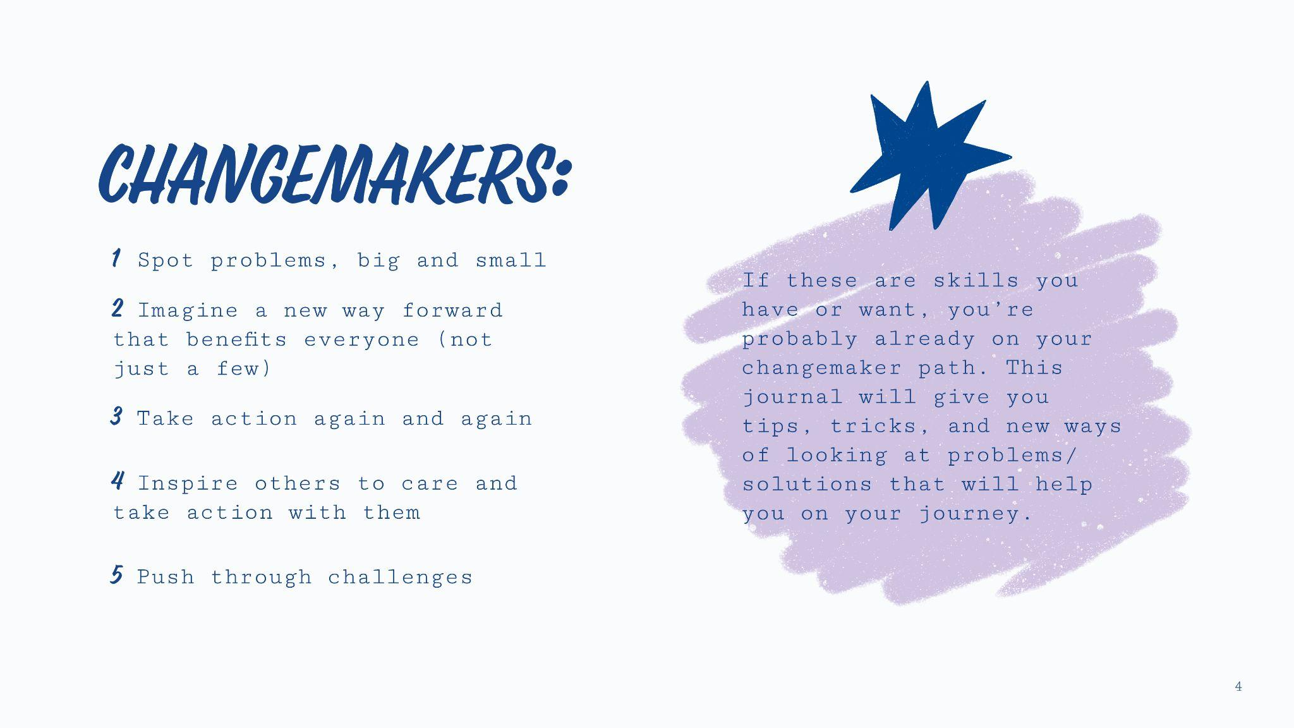

Slide 5
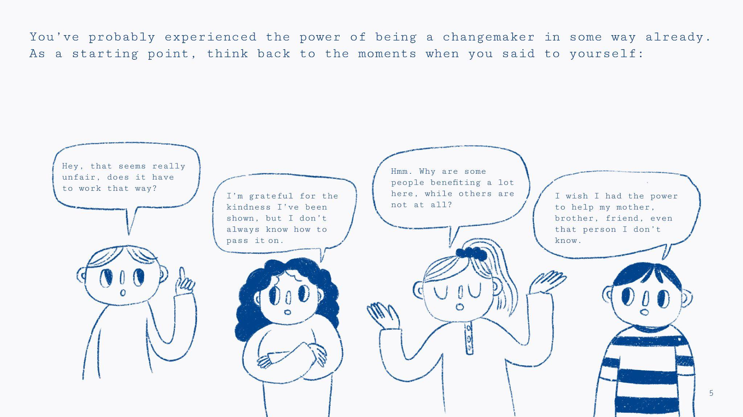

Slide 6


Slide 7


Slide 8


Slide 9
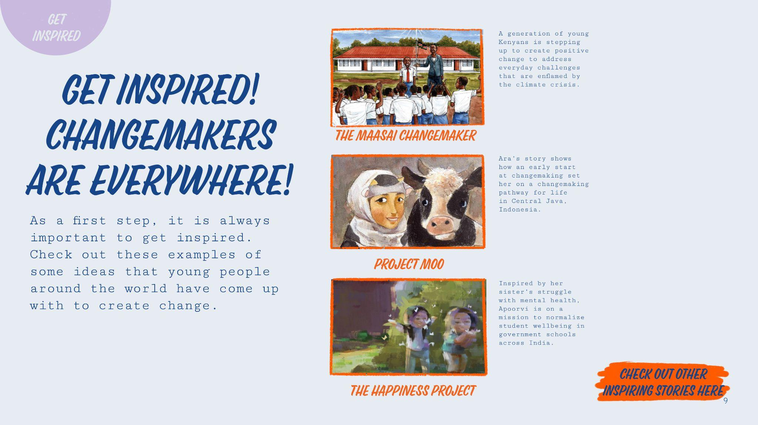

Slide 10
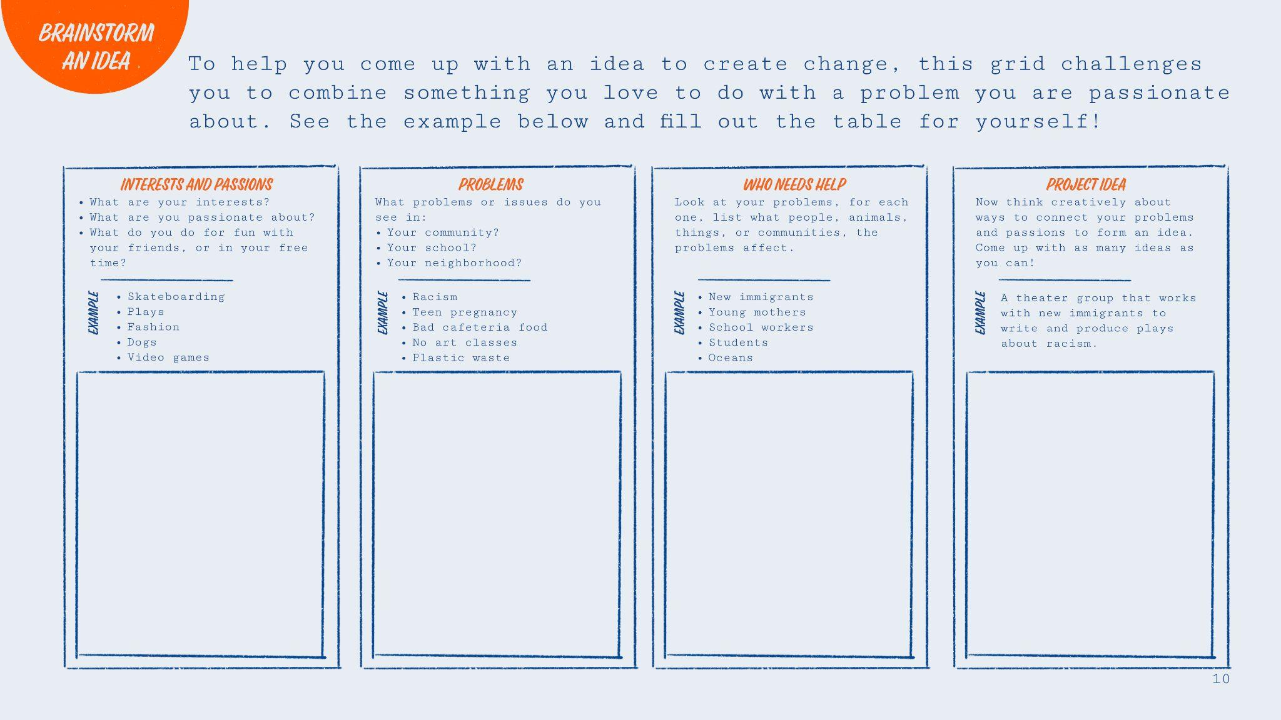
Write here
Write here
Write here
Write here

Slide 11
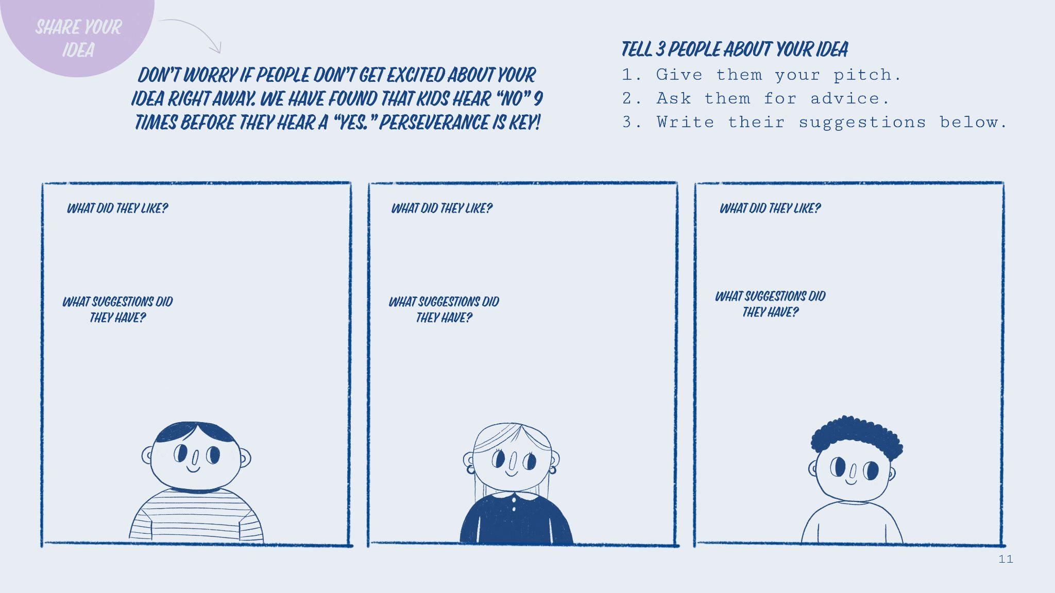
Write here
Write here
Write here
Write here
Write here
Write here

Slide 12
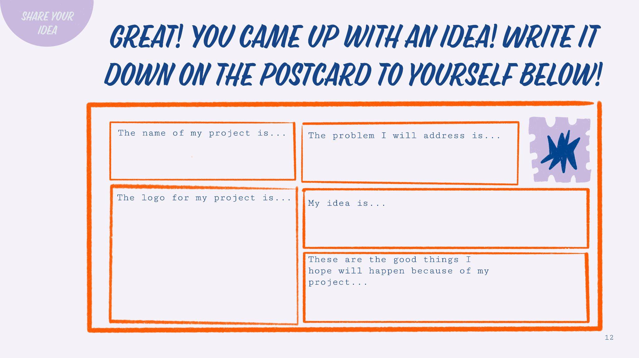
Write here
Write here
Write here
Write here

Slide 13

Write here
Write here
Write here
Write here
Write here

Slide 14


Slide 15


Slide 16
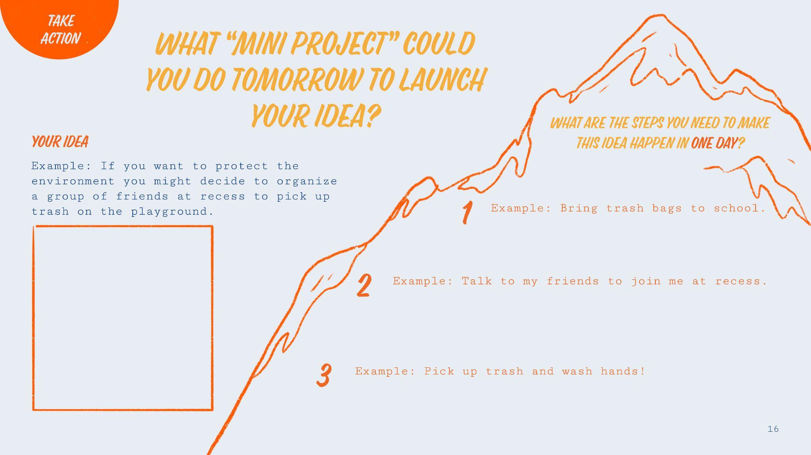
Write here
Write here
Write here
Write here

Slide 17
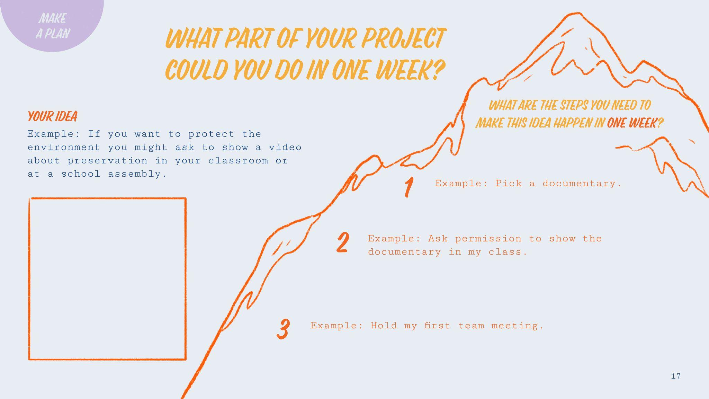
Write here
Write here
Write here
Write here

Slide 18
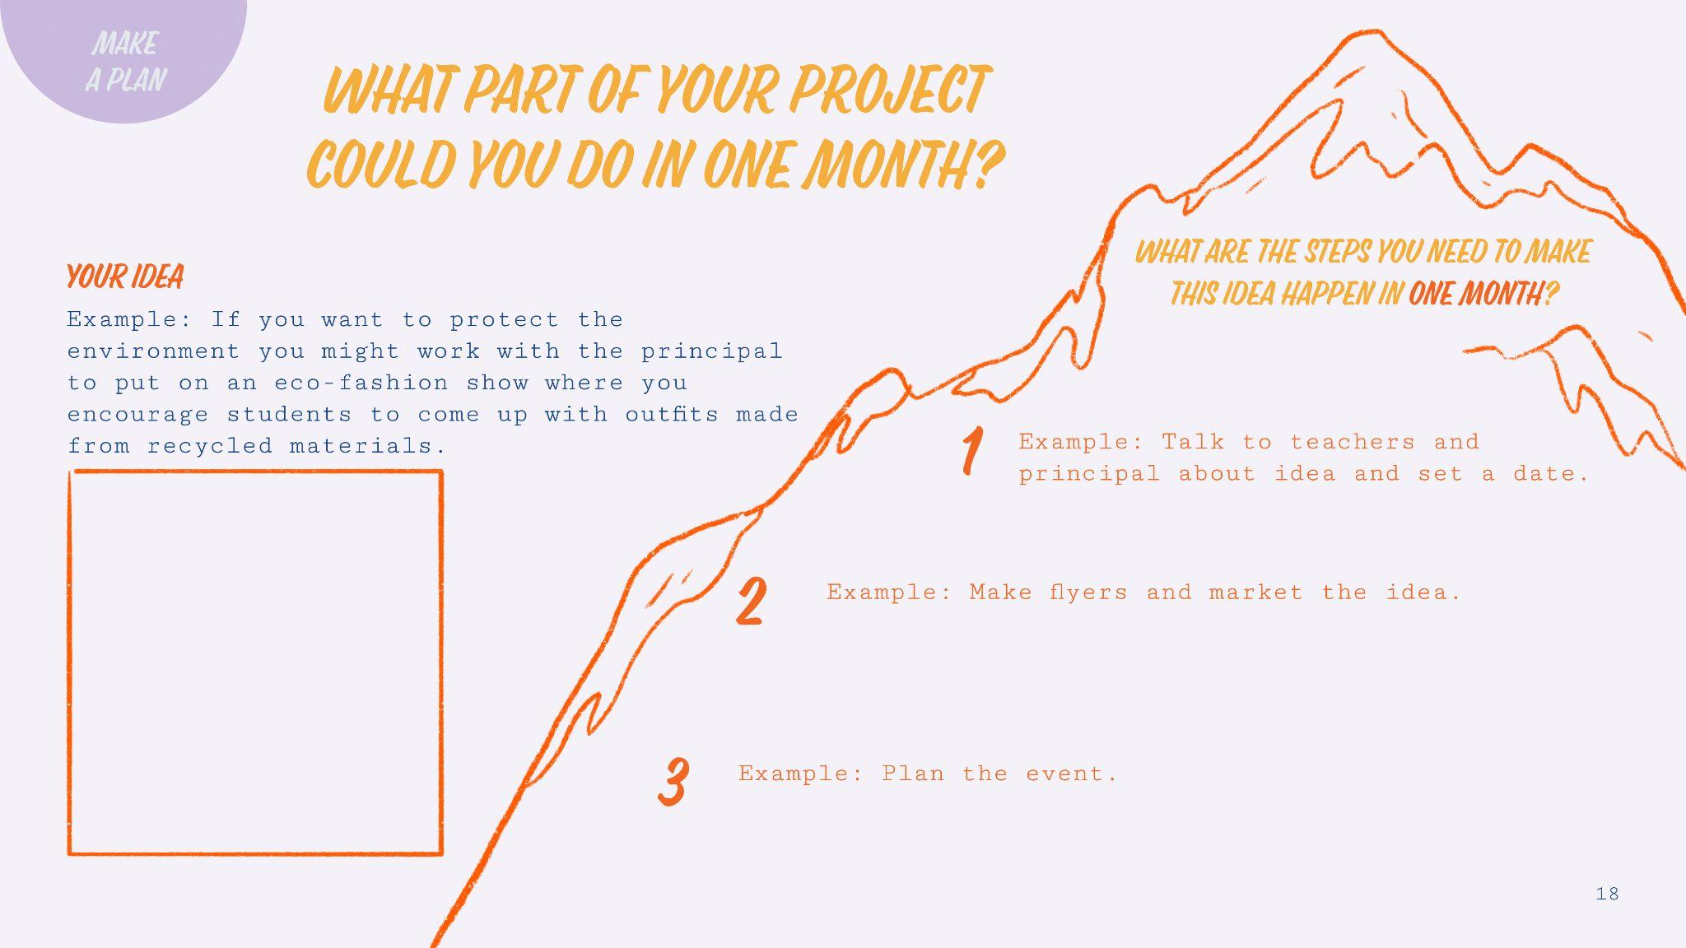
Write here
Write here
Write here
Write here

Slide 19

Write here
Write here

Slide 20
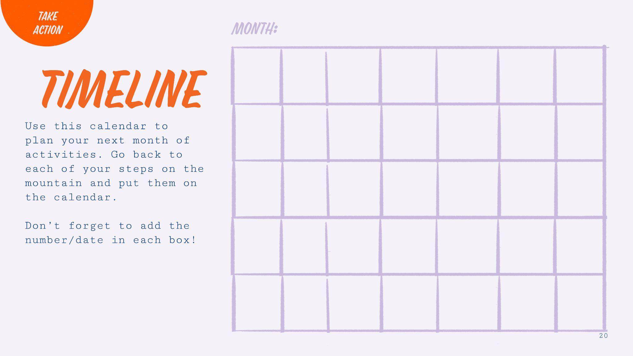
Write here…
date
date
date
date
date
date
date
Write here…
Write here…
Write here…
Write here…
Write here…
Write here…
Write here…
date
date
date
date
date
date
date
Write here…
Write here…
Write here…
Write here…
Write here…
Write here…
Write here…
date
date
date
date
date
date
date
Write here…
Write here…
Write here…
Write here…
Write here…
Write here…
Write here…
date
date
date
date
date
date
date
Write here…
Write here…
Write here…
Write here…
Write here…
Write here…
Write here…
date
date
date
date
date
date
date
Write here…
Write here…
Write here…
Write here…
Write here…
Write here…
Write here…

Slide 21
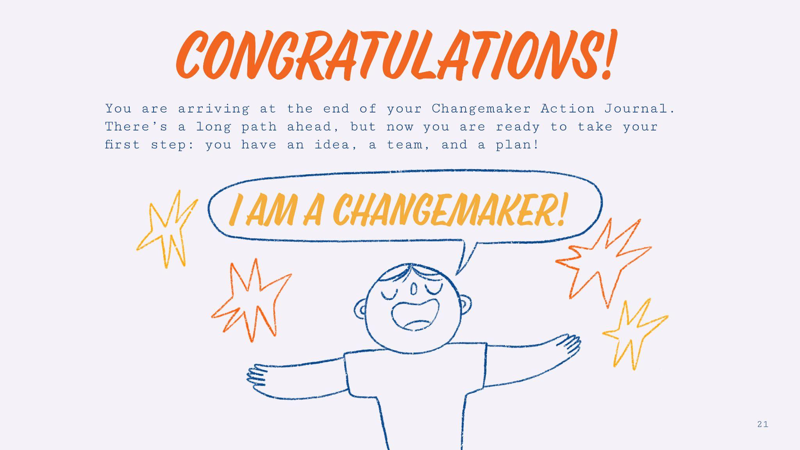

Slide 22


Slide 23
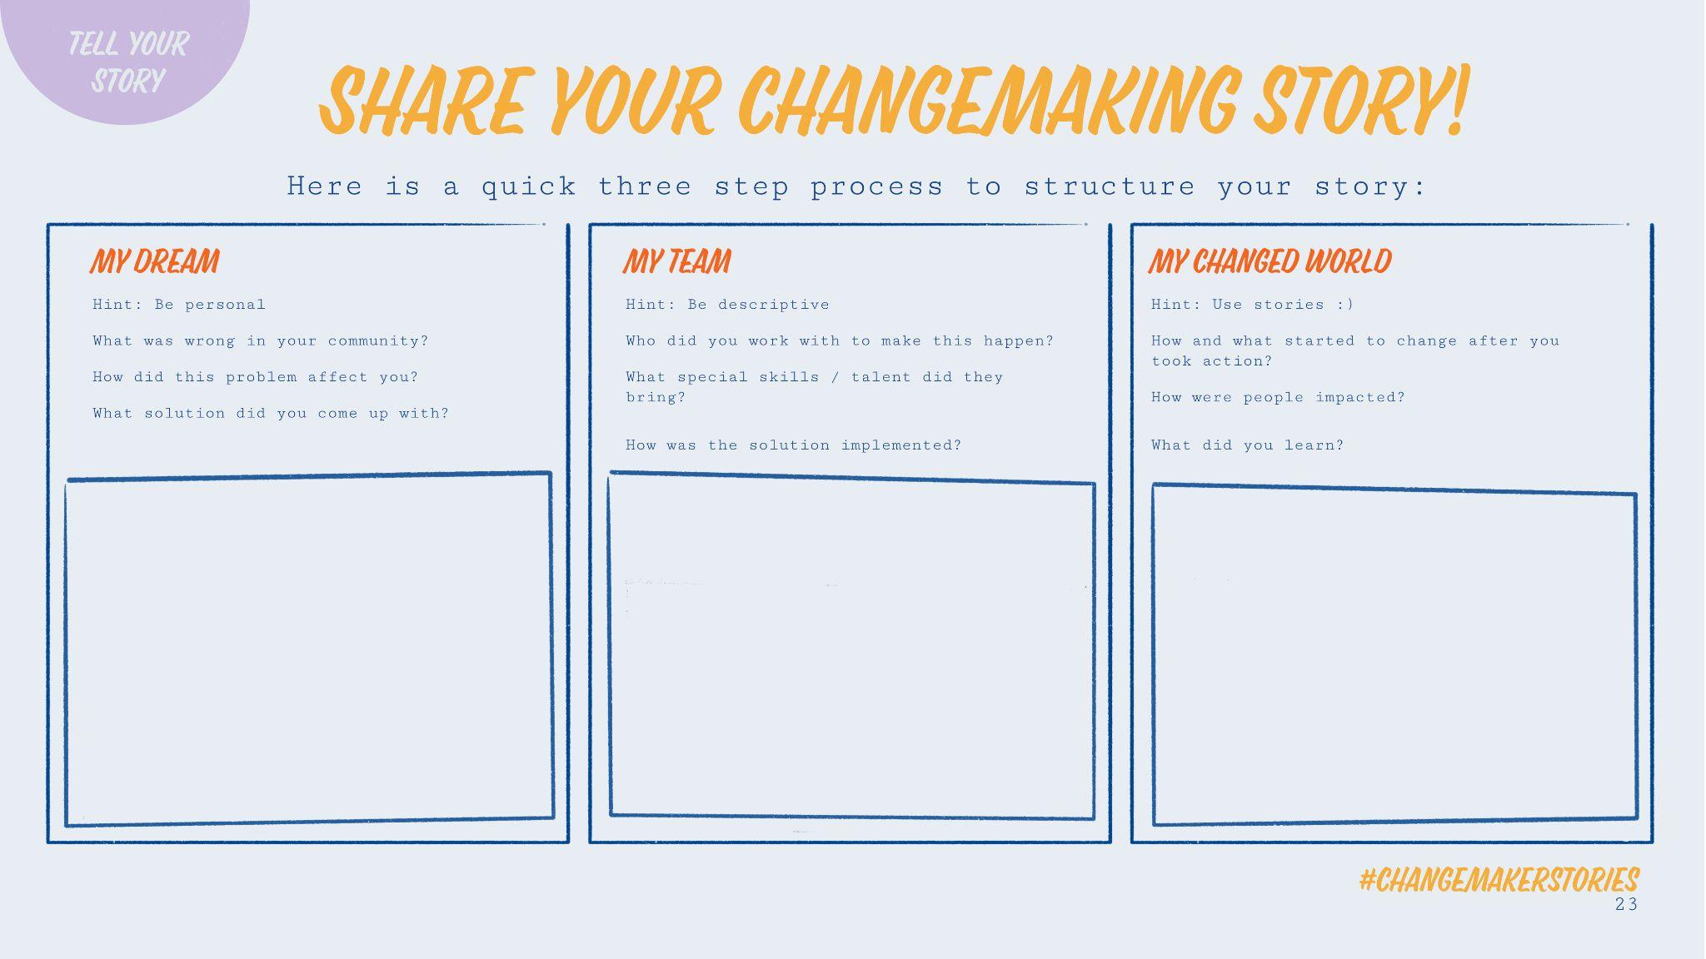
Write here
Write here
Write here

Slide 24


Slide 25




